Slide 1
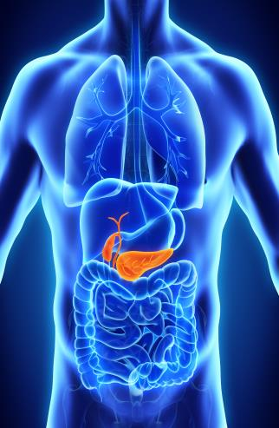
Healthy Gut Program
Comprehensive Gut and Digestive Wellness*
With Immune Support Built In.*
*These statements have not been evaluated by the Food and Drug Administration. These products are not intended to diagnose, treat, cure, or prevent any disease.

Slide 2
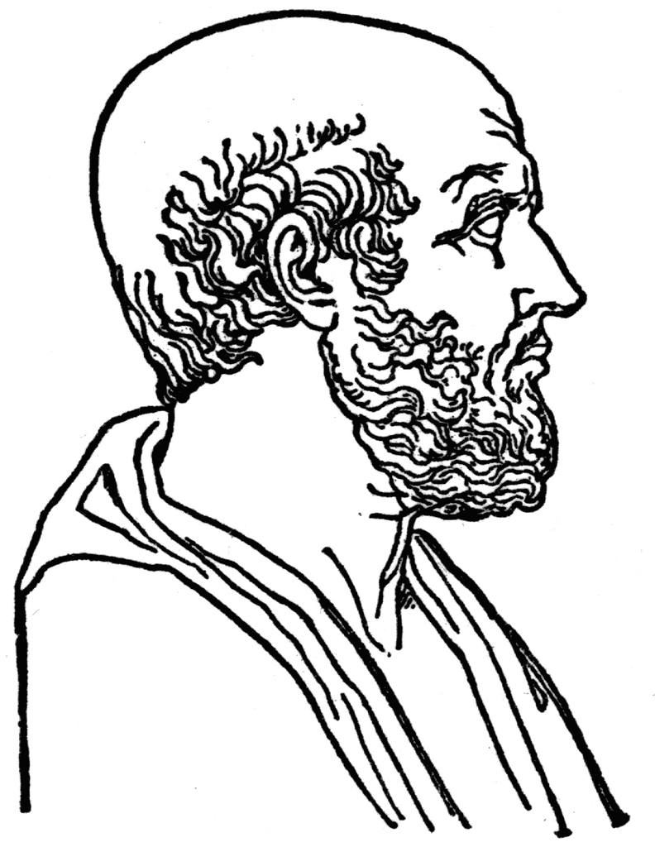
“All disease begins in the gut” † *
†Hippocrates believed that human health is directly connected to gut function.
*These statements have not been evaluated by the Food and Drug Administration. These products are not intended to diagnose, treat, cure, or prevent any disease.
Notes:
More than 2000 years ago, the famous ancient Greek doctor Hippocrates, one of the founders of medical science, said: 'All diseases begin in the gut.'

Slide 3


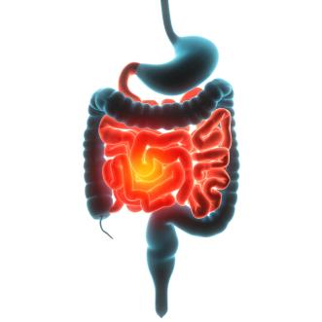






Gut imbalance can affect immune function and overall digestive health*
*These statements have not been evaluated by the Food and Drug Administration. These products are not intended to diagnose, treat, cure, or prevent any disease.
Notes:
This conclusion is supported by numerous scientific studies that demonstrate the connection between gut health and immunity, which, in turn, affects the risk of developing a wide range of diseases.
Today, disruptions in gut function are linked not only to constipation and diarrhea, but also to headaches, allergies, chronic runny nose and cough, sleep disorders, gingivitis, fatigue, apathy, reduced brain efficiency, and mood deterioration. Gut problems also have a negative impact on appearance: skin tone becomes pale and unhealthy, rashes appear, early wrinkles develop, hair becomes brittle, dry, and starts falling out.
If these warning signs are ignored and no steps are taken to improve gut health, serious health issues may arise soon.

Slide 4
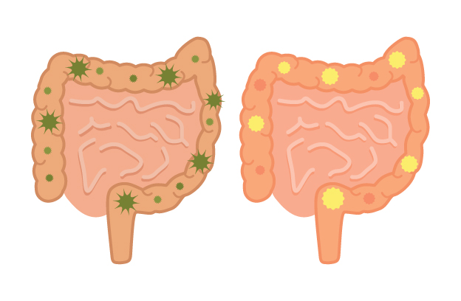



Less beneficial microbes can multiply on fast carbs*
Beneficial flora thrive on fiber and fermented foods*
*These statements have not been evaluated by the Food and Drug Administration. These products are not intended to diagnose, treat, cure, or prevent any disease.
Notes:
To understand why gut health has such a profound impact on our physical, emotional, and cognitive well-being, let's break down how the gut microbiome or microbiota functions.
Today, terms like microbiome and microbiota are increasingly used instead of the traditional "microflora," as they more accurately reflect the composition of this biosystem. The reason for this is that bacteria, fungi, viruses, and other microorganisms inhabiting the gut are not technically flora, so calling them "microflora" is not entirely correct (although this term is still used).
Some of the microorganisms that make up the microbiome are our friends, while others are freeloaders and adversaries. The first group includes bifidobacteria and lactobacilli, while the second group consists of pathogenic microorganisms.
If you consume enough fiber (at least 400 grams of vegetables and fruits daily, as recommended by the WHO) and live fermented dairy products, you support the beneficial microorganisms and improve the overall state of your microbiome.
On the other hand, if you eat a lot of fast sugars and refined products with high sugar content and low nutritional value, you are essentially "feeding" the harmful microbiota. The more harmful food in your diet, the more frequent disruptions occur in your gut's functioning.
And the worse your health becomes.

Slide 5
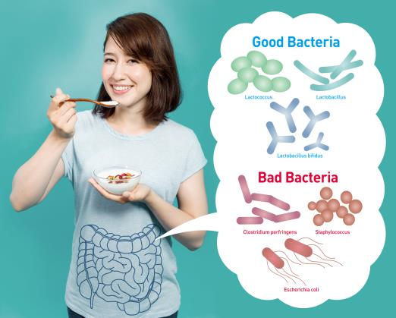
3.3 lbs.
An average person carries about 3 pounds of gut bacteria. † This internal ecosystem helps maintain balance and harmony*
† Sender R., Fuchs S., Milo R. Are we really vastly outnumbered? Revisiting the ratio of bacterial to host cells in humans. Cell. 2016; 164(3): 337–340.
*These statements have not been evaluated by the Food and Drug Administration. These products are not intended to diagnose, treat, cure, or prevent any disease.
A balanced microbiome = a healthy body!*
Notes:
The total weight of the bacteria living in a person's gut is about 3.3 pounds.
This "community" regulates many vital processes in the body and even influences our behavior, which is why it's crucial for it to be in harmony! Note this reference: † Sender R., Fuchs S., Milo R. Are we really vastly outnumbered? Revisiting the ratio of bacterial to host cells in humans. Cell. 2016; 164(3): 337–340. ]
[https://doi.org/10.1016/j.cell.2016.01.013

Slide 6

70%
70% of the body’s immune cells reside in the gut lining. † *
An unbalanced gut may influence the body’s natural immune response.*
† Canadian Digestive Health Foundation. How Nutrition Can Support Gut Health and the Immune System. Updated April 2023.
*These statements have not been evaluated by the Food and Drug Administration. These products are not intended to diagnose, treat, cure, or prevent any disease.
Notes:
This is not surprising, as the gut plays an active role in the body's defense mechanisms against pathogenic microorganisms that cause various diseases.
Around 70% of all immune cells in the body are located in its mucous membrane. About 25% of the intestinal mucosa consists of immunologically active tissue and cells. Every meter of the gut contains approximately 10^10 lymphocytes, which destroy foreign cells, block allergens, and prevent the entry of foreign substances and pathogenic bacteria into the bloodstream.
When the microbiome balance is disrupted (for example, due to poor nutrition), the gut cannot fully perform its immunomodulatory function because the body doesn't receive the necessary nutrients. As a result, a person starts getting sick more often, especially during the "cold season."
Canadian Digestive Health Foundation: [https://cdhf.ca/en/how-nutrition-can-support-gut-health-and-the-immune-system/ ]

Slide 7


100 mil
100,000,000 nerve cells are included in the gut’s nervous system. † *
The gut and brain are closely connected—an unbalanced gut may affect mood, focus, and overall mental well-being. † *
*These statements have not been evaluated by the Food and Drug Administration. These products are not intended to diagnose, treat, cure, or prevent any disease.
†John Hopkins Medicine. The Brain-Gut Connection, https://www.hopkinsmedicine.org/health/wellness-and-prevention/the-brain-gut-connection
Notes:
The gut also largely determines the functioning of the nervous system, and thus the effectiveness of brain function, mood, and the ability to cope with stress.
It’s astonishing, but there are about 100 million nerve cells in the gut! This is why the gut is often referred to as the “second brain,” emphasizing its connection with cognitive abilities and emotional states. Indeed, stress and bouts of depression are often accompanied by digestive disorders and bloating.
You’ve probably noticed that the gut reacts sharply to certain negative emotions. Fear may cause a sensation of tightness below the chest, while strong anxiety increases peristalsis and may even lead to what’s known as "bear disease." The infamous “butterflies in the stomach” are not just a metaphor, but a tangible reaction of the “gut brain” to pleasant excitement.
A significant amount of serotonin (the "happiness hormone") is synthesized in the gastrointestinal tract. Disruption of this function can lead to depression, disturbances in the “sleep-wake” cycle, impaired memory and cognitive abilities, irritability, and lack of self-confidence. See Hopkins Medicine [https://www.hopkinsmedicine.org/health/wellness-and-prevention/the-brain-gut-connection ] See HSPH [https://www.health.harvard.edu/diseases-and-conditions/the-gut-brain-connection ]

Slide 8


0%
When digestion is insufficient, nutrients may not be fully absorbed.*
This may contribute to occasional fatigue and low energy.*
*These statements have not been evaluated by the Food and Drug Administration. These products are not intended to diagnose, treat, cure, or prevent any disease.
Notes:
Energy levels are also directly linked to the efficiency of the digestive system.
If we mainly consume refined products and convenience foods, the body doesn’t receive the necessary proteins, fats, carbohydrates, dietary fibers, vitamins, and minerals in amounts sufficient for full-fledged functioning.
When metabolism is normal, a person enjoys good health and is full of energy. On the other hand, weakness, quick fatigue, and reduced performance are common signs that digestion and nutrient absorption are not functioning well.

Slide 9


Weight Imbalance*
When gut flora is healthy, carbs burn faster, and weight stays in check.*
*These statements have not been evaluated by the Food and Drug Administration. These products are not intended to diagnose, treat, cure, or prevent any disease.
Unhealthy Gut = Slower Metabolism*
Notes:
...and, of course, an imbalance in the gut microbiome leads to excess weight that just won’t go away!
Friendly bacteria control the body's response to carbohydrates, converting them into fat or energy. If you eat quality and diverse food (or supplement your diet with necessary bioactive additives), you keep the microbiome in balance. As a result, carbohydrate fermentation improves, which facilitates their burning and thus reduces the risk of obesity and type 2 diabetes.
Beneficial gut bacteria are involved in the synthesis of essential health substances (such as B vitamins), so their insufficient activity negatively affects the condition of the skin and hair, which are the first to suffer from nutrient deficiencies.
When a large amount of toxins accumulates in the gut and liver, the digestive system is unable to evacuate them on its own, and toxins begin to be excreted through the skin. This results in a dull complexion, the appearance of rashes, and acne.

Slide 10

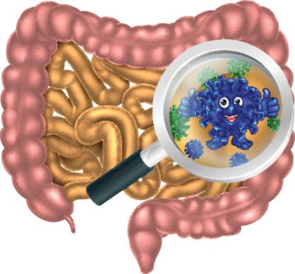
When your gut is working properly…
You may feel energized, youthful, and full of life!*
*These statements have not been evaluated by the Food and Drug Administration. These products are not intended to diagnose, treat, cure, or prevent any disease.
Notes:
As we can see, the gut is a mirror of health. When it works like clockwork, a person has strong immunity and gets sick less often.
The result: they are energetic, satisfied, quick to get up, fit, and look great!
It’s no coincidence that gut health is currently at the forefront of attention for medical scientists and nutrition experts.

Slide 11




Common Factors that Disrupt Gut Balance
Medications
Stress
Poor diet
Sedentary lifestyle or excessive alcohol intake
Notes:
Unfortunately, the vast majority of people today have problems with their intestines. In the life of almost every one of us, there are constant factors that provoke disruptions in the functioning of this vital organ.
Unbalanced diet (lack of fiber, live dairy products, and fermented foods; predominance of refined food with low nutritional value, and fast carbohydrates).
Lack of a daily water intake habit (the daily norm is 1.5–2 liters). Without enough water, peristalsis worsens, and our "waste" cannot move freely through the intestines. As a result, constipation occurs, and toxins are not evacuated from the body in time.
Stress. Increased levels of anxiety, according to experts, can trigger irritable bowel syndrome.
Medication. Antibiotics kill not only the bad but also the good microorganisms, often leading to intestinal disturbances. Additionally, some medications have side effects such as diarrhea and other gastrointestinal disorders.
Sedentary lifestyle (sitting work, lack of exercise or physical activity). A lack of movement reduces the tone of the abdominal muscles and, consequently, the tone and peristalsis of the intestines. On average, people who sit most of the day suffer from constipation 2–3 times more often than those who are physically active.

Slide 12

So what can you do about it?
Notes:
If any attempts were made to address such situations, they were most likely of a local and short-term nature. For example, this could have been taking probiotics after antibiotic treatment or enzymes after a gastrointestinal infection.
However, these are all temporary measures that provide short-term relief but do not solve the problem as a whole.

Slide 13




A comprehensive approach –
Involves a program that cleanses, restores microbiome balance, and addresses any nutrient deficiencies.
“Miracle” fixes —
These involve solving problems with a special recipe that incorporates secret or exotic ingredients, offering an instant solution. However, such fixes are unsustainable without accompanying nutritional guidance.
Notes:
If we want to be healthy and have a strong immune system, we must approach the problem comprehensively. The body is a unified system where all life processes are interconnected and interdependent. The intestines, as the primary "nourishing" organ, should be the first focus on this journey. The health of every cell depends on the proper functioning of the intestines, as each cell must receive a specific set of nutrients daily to fully perform its functions.
Therefore:
Opt for comprehensive programs produced by reputable companies. Avoid "magic pills" that claim to eliminate the negative effects of years of dietary excesses, intoxication, and other factors in a short time. There are no miracles.
Remember that effective and safe gut health recovery takes time – typically more than a week. The body is a complex system, and its function cannot be reprogrammed in a few days. It’s not only necessary to evacuate excess waste and toxins (which most detox programs focus on), but also to replenish what’s missing and restore the balance of gut flora.
Keep in mind that the program should be accompanied by dietary recommendations. If a manufacturer claims that their product will normalize digestion (and at the same time, "cleanse" and help you lose weight) without changing your usual diet, they are not to be trusted. Typically, such "miracle" products feature exotic, rare, and hard-to-find ingredients with an enticing story or, conversely, a "secret scientific development" that was previously available only to the select few. This captures the imagination of the naive consumer and justifies the inflated price.

Slide 14
Targeted Program: Healthy Gut
coral-club.com
Notes:
This is the first targeted program from Coral Club, embodying a comprehensive approach to health. It includes products designed for the systematic, step-by-step restoration of the intestines and other digestive organs involved in the processes of digestion and nutrient absorption. It’s convenient: all the necessary products, in the right quantities and combinations, are neatly packaged in blisters and compactly organized by stage. Application and dietary recommendations are included. This is a ready-made solution in one box, unmatched in the market.

Slide 15
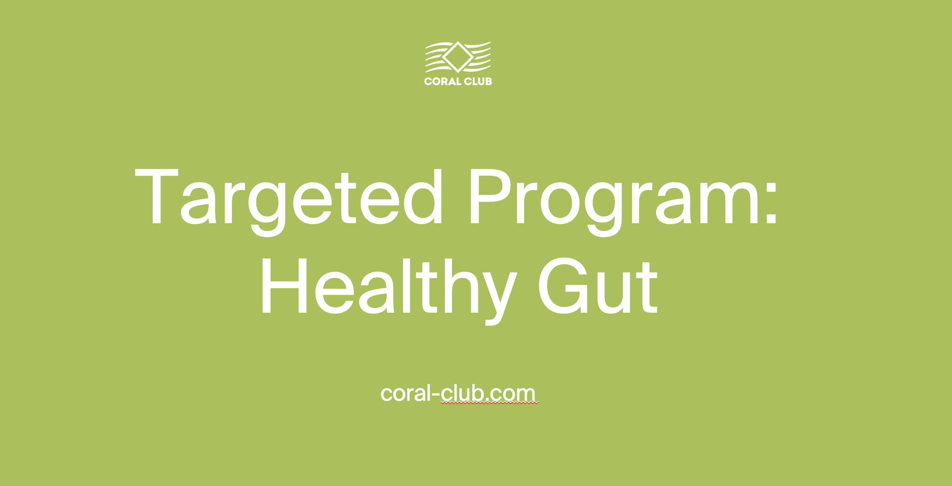
THE “HEALTHY GUT” PROGRAM HELPS:
Support digestive health*
Support the immune system*
Help maintain healthy metabolism*
Support overall well-being and appearance*
*These statements have not been evaluated by the Food and Drug Administration. These products are not intended to diagnose, treat, cure, or prevent any disease.
Notes:
The "Healthy Gut" Program helps to:
Normalize the function of the intestines – a crucial organ whose performance directly impacts the effectiveness of various body systems.
Strengthen the immune system, enhancing resistance to infections and viruses.
Restore metabolic balance.
Improve overall well-being and appearance.

Slide 16
THE PROGRAM HAS 3 PHASES:
GENTLE DETOX (DAYS 1 – 10)
NORMALIZATION (DAYS 11 – 20)
RESTORATION (DAYS 21 – 30)
Notes:
The "Healthy Gut" Program – the result of 20 years of expertise from the company and the outcome of extensive collaboration between nutrition specialists and Coral Club.
We don’t promise a "miracle effect" over the weekend. The "Healthy Gut" program is a gradual process, during which the gut undergoes a careful, step-by-step recovery. The program is designed for 30 days and is divided into three stages, each lasting 10 days.

Slide 17

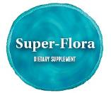




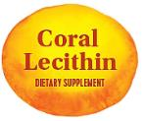
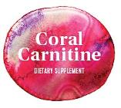

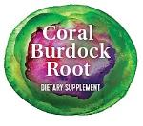
Step 1: A GENTLE DETOX
Supports the body’s natural cleansing processes and elimination pathways.*
This step helps support the liver, gallbladder, and kidney function already within the normal range.*
*These statements have not been evaluated by the Food and Drug Administration. These products are not intended to diagnose, treat, cure, or prevent any disease.
Notes:
Stage 1 of the Program – GENTLE CLEANSING
In this stage, the intestines undergo a gentle cleansing. The body is freed from toxic substances and parasites (helminths). Bile production is activated, and the kidney drainage system is supported.
Products used in Stage 1:
Super-Flora (promotes the growth of beneficial bacteria and improves gut microbiota health)
Zaferan (stimulates bile production and flow, improves digestion, and helps lower cholesterol levels)
Black Walnut Leaves (possess antiparasitic and mild laxative effects, support the health of the intestinal mucosa, and lower cholesterol)
Papaya (aids protein breakdown, activates intestinal function, reduces mucosal irritation, and accelerates mucosal regeneration)
Coral Alfalfa (cleanses intestinal villi while providing the body with minerals, amino acids, and vitamins)
Coral Lecithin (essential for the renewal and repair of damaged cells, including lymphocytes and macrophages—cells of the immune system, as well as liver cells)
Coral Burdock Root (assists in the detoxification of the kidneys, liver, and gallbladder)
Cascara Sagrada (a gentle laxative that promotes regular bowel movements)
Coral Carnitine (accelerates fat breakdown, releasing energy needed to maintain high vitality, and eliminates toxic compounds, preventing their buildup)

Slide 18
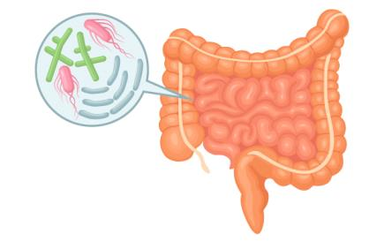
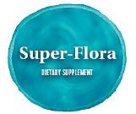

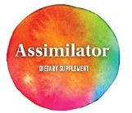

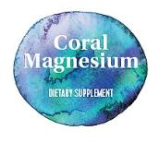
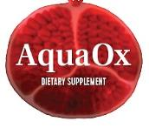
Step 2: NORMALIZATION
Helps maintain healthy gut flora.* Supports digestion and nutrient absorption.* Supports normal secretory function of the gut.*
*These statements have not been evaluated by the Food and Drug Administration. These products are not intended to diagnose, treat, cure, or prevent any disease.
Notes:
Stage 2 of the Program – NORMALIZATION of Function
The goal of this stage is to bring the gut microbiome to a balanced state, where microorganisms from different groups coexist in harmony, regulating each other’s growth.
To achieve this, Stage 2 includes products that promote the increase and restoration of beneficial bacteria, optimize digestion, and regulate enzyme synthesis.
This is a crucial part of the healing process, ultimately determining the quality of nutrient and energy absorption in the digestive system.
PRODUCTS PARTICIPATING IN THIS STAGE:
Super-Flora
Zaferan
Coral Lecithin
Assimilator (a complex of plant-based enzymes that improves digestion and nutrient absorption. Vitamins A and D help restore the mucous membranes of the digestive system, while vitamin D regulates the synthesis of digestive enzymes and hormones).
Coral Artichoke (contains the best hepatoprotectors, supporting liver health and the bile ducts).
Coral Magnesium (normalizes intestinal, gallbladder, and urinary bladder motility, improves nutrient, vitamin, and mineral absorption, and activates energy production).
AquaOx (plant-based antioxidant extracts in this product positively impact vascular health, cholesterol levels, and provide a general tonic effect).

Slide 19
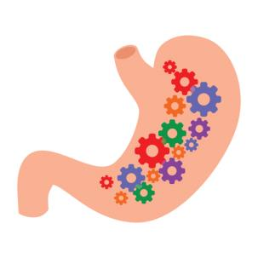
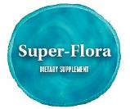





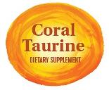



Step 3: RESTORATION
Helps maintain healthy digestive function.* Supports a healthy balance of gut flora.* Supports the body’s balance of vitamins, minerals, and metabolic processes.*
*These statements have not been evaluated by the Food and Drug Administration. These products are not intended to diagnose, treat, cure, or prevent any disease.
Notes:
Stage 3 of the Program – RESTORATION
During this phase, digestive function is normalized. The restoration of beneficial bacteria continues, optimizing the food breakdown process. To boost the population of beneficial bacteria and provide them with necessary nutrition, the program includes products rich in dietary fibers. Enzymes contribute to the proper digestion and absorption of nutrients. Vitamin and mineral deficiencies are addressed. Amino acids restore protein metabolism. Antioxidants protect the digestive system tissues and promote their accelerated regeneration.
PRODUCTS PARTICIPATING IN STAGE 3:
Super-Flora
Papaya
Coral Alfalfa
Coral Magnesium
Zaferan
Coral Taurine – A "universal" amino acid, essential for normal body function. It enhances magnesium absorption, has significant antioxidant activity, supports liver detoxification, and helps normalize bile secretion, which improves digestion.
Omega 3/60 – Polyunsaturated fatty acids necessary for the normal functioning of virtually all organs and systems, including the digestive system. Researchers from the University of Nottingham Medical School and the Royal College (London) have proven that PUFAs positively impact gut biodiversity.
24/7 – Contains a broad complex of vitamins (including B vitamins, which are vital for the normal functioning of gut microbiota), micro and macro elements, and plant components (algae, grains, fruits, and berries).
MSM – A source of sulfur, which decreases with age. However, sulfur is crucial for the continuous renewal of mucosal cells, as their regeneration rate is 1 million cells per minute.
Spirulina – A source of easily digestible amino acids, which are necessary for the synthesis of digestive enzymes.

Slide 20
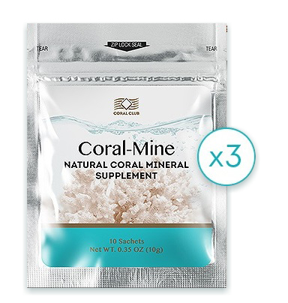
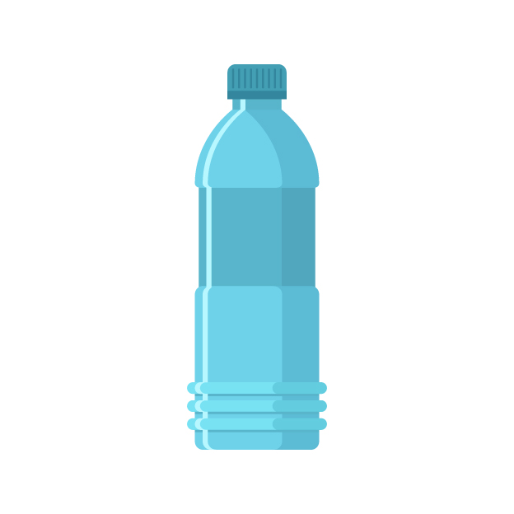
HIGH QUALITY H2O IS ESSENTIAL FOR DETOX The mineral composition of Coral-Mine supports your system throughout the entire program.*
*These statements have not been evaluated by the Food and Drug Administration. This product is not intended to diagnose, treat, cure, or prevent any disease.
Notes:
Water is a crucial component of all three stages of the "Healthy Gut" program.
It is essential for normalizing the water-salt and acid-base balance, as well as for proper digestive system function. Tap water is not the best option, as it often contains undesirable impurities.
An excellent solution is using the Coral-Mine mineral composition to enhance the quality of drinking water.
Recommended water intake during the program: At least 1.5 liters of water with Coral-Mine mineral composition, either 30 minutes before meals or 1.5 to 2 hours after.

Slide 21
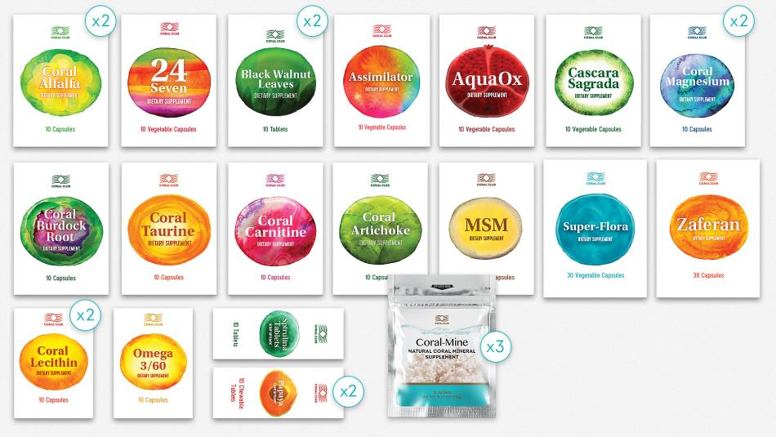
19 CORAL CLUB PRODUCTS INCLUDED!
Notes:
As you can see, the "Healthy Gut" program includes 19 products from Coral Club.
Please note: purchasing them separately would cost much more than when included in the program!
The "Healthy Gut" program is also a great value!

Slide 22
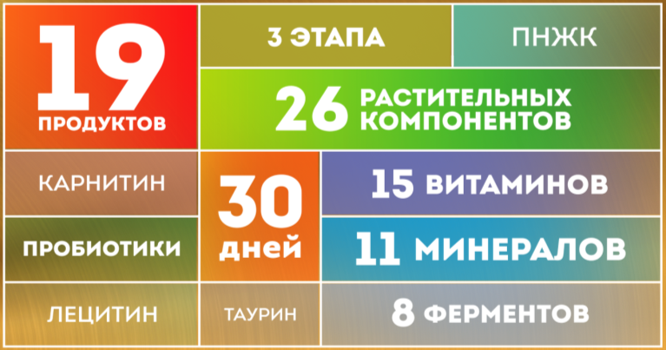
IT’S ALL INCLUSIVE!
3 STAGES PUFA
19 products
Carnitine
Probiotics Lecithin
26 plant-based extracts
15 Vitamins
11 Minerals 8 Enzymes
30 days
Taurine
Notes:
Everything You Need Is Already Included
19 products rich in beneficial bioactive substances: 14 vitamins, 8 enzymes, 11 minerals, as well as probiotics, inulin, plant components, omega-3 fatty acids, carnitine, and taurine.
And all of these work in synergy, harmoniously complementing and enhancing each other's effects!
Despite the complex composition, the program is incredibly easy to use—simply follow the included instructions, adhere to the straightforward dietary recommendations, and remember to drink water every day!

Slide 23
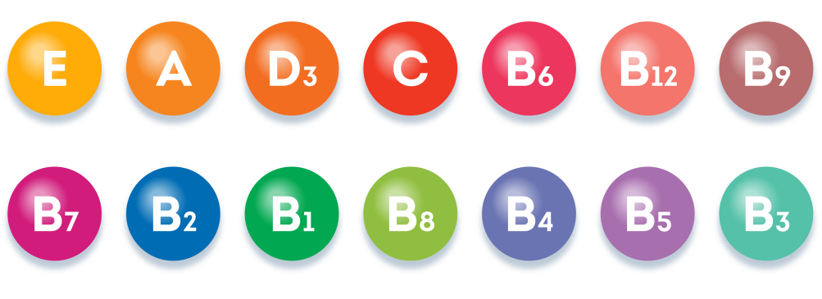
14 Essential Vitamins
Notes:
14 Vitamins Essential for Addressing Vitamin Deficiency
Vitamin deficiency often develops due to an imbalanced diet, smoking, alcohol consumption, coffee and energy drinks, the use of certain medications, regular stress, intense intellectual and physical activity, or living in unfavorable environmental conditions.

Slide 24
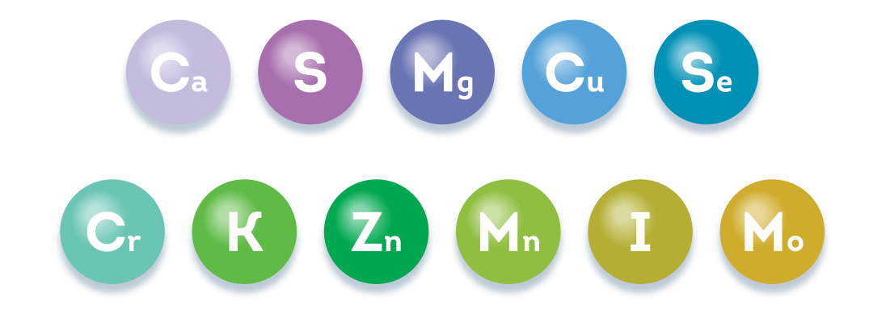
11 Vital Minerals
Notes:
11 Essential Minerals for Health
Calcium: Supports strong bones and joint health.
Sulfur: Promotes healthy skin, hair, and nails.
Magnesium: Helps reduce stress, prevent cramps, alleviate headaches, and regulate heart rhythm.
Copper: Fights anemia and fatigue.
Selenium: Supports immune function and overall health, including reproductive health.
Chromium: Promotes healthy sleep and helps regulate cholesterol levels.
Potassium: Boosts energy and ensures the stable function of the heart and nervous system.
Zinc: Strengthens immunity, prevents hair loss, and improves nail health.
Manganese: Helps regulate blood sugar and cholesterol levels, and prevents diabetes.
Iodine: Essential for thyroid health.
Molybdenum: Regulates metabolic processes and enhances enzyme activity.

Slide 25


PLANT-BASED EXTRACTS, INCLUDING:
Black walnut, aloe, spirulina, ginseng, alfalfa, acai, pomegranate, turmeric, rhodiola
Notes:
26 Plant-Based Ingredients Beneficial for Digestive Health
Black Walnut: Fights against parasitic infections.
Turmeric: Helps control weight and normalize metabolism.
Burdock Root: A well-known detoxifier.
Spirulina: A rich source of essential amino acids and vitamin B12.
Aloe Vera: A powerful natural immune booster, containing biologically active anthraquinones with a mild laxative effect and supporting toxin removal.
Blueberry: Helps lower blood sugar levels and restores pancreatic function.
Broccoli: A source of sulforaphane, which stimulates enzyme production.
Cranberry: Supports urinary tract health.
Grapes: A source of polyphenols, protecting against premature aging and promoting overall health.
Raspberries: Help control appetite and aid in the accelerated breakdown of fats.
Spinach: Improves metabolism, provides essential nutrients, and participates in the detoxification process.
Ginseng: A legendary adaptogen that boosts energy levels, enhances performance, and strengthens immunity.
Rhodiola: Enhances the body’s ability to adapt to stress and physical exertion.
Cayenne Pepper: A source of capsaicin, which stimulates the production of enzymes involved in fat burning and accelerates metabolic processes.
Garlic: A well-known remedy for combating parasites.
Ginger: Used for centuries to stimulate digestion and strengthen immunity.
Papaya: A source of enzymes that assist in digestion and improve nutrient absorption.
Rosehip: Contains a record amount of vitamin C and other antioxidants.
Hawthorn: A rich source of antioxidants.
Fennel: Helps control appetite.
Alfalfa: Packed with vitamins, minerals, and chlorophyll.
Buckthorn: A gentle and safe plant-based laxative.
Pomegranate: Improves blood formation, enhances resistance to infections and viruses.
Acai: A powerful antioxidant, a popular ingredient in modern beauty and slimming products.
Rosemary: Stimulates gastric juice secretion, enhancing digestion.
Cocoa: Reduces the risk of stomach ulcers, protecting the stomach lining from irritation.

Slide 26

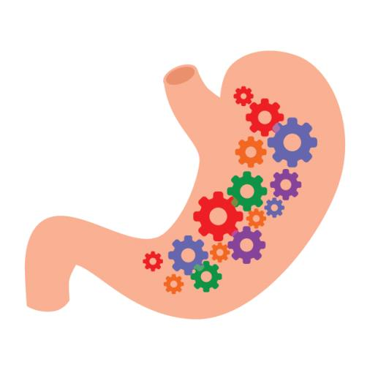

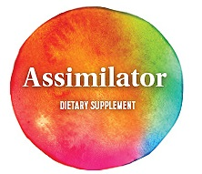
8 ENZYMES:
Protease, amylase, lactase, cellulase, maltase, lipase, papain, bromelain
Notes:
8 Digestive Enzymes
Enzymes accelerate digestive processes by breaking down proteins, fats, and carbohydrates, and also help neutralize harmful substances.
Lactase – supports more efficient digestion of dairy products by breaking down milk sugar (lactose).
Cellulase – assists in breaking down cellulose, making it easier to digest dietary fiber.
Maltase, along with sucrase and protease, plays a key role in the breakdown of sugars.
Papain – a plant-based enzyme from papaya, essential for effective nutrient absorption.
Bromelain – a pineapple-derived enzyme that speeds up protein digestion. It works across a wide pH range and remains active in the acidic environment of the stomach.

Slide 27
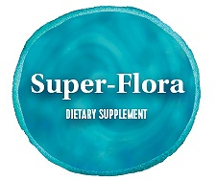
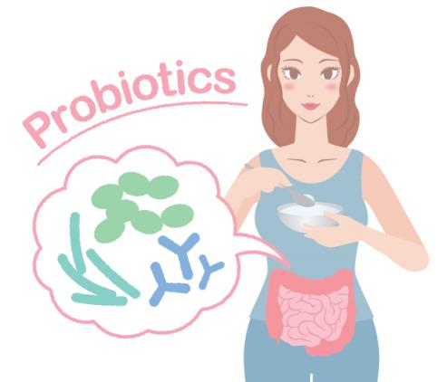
PROBIOTIC SUPPORT
Lactobacillus, bifidobacteria, inulin
Notes:
Products containing probiotics and inulin increase the number of beneficial bifidobacteria and lactobacilli and support their well-being. Dietary fiber and inulin provide essential nourishment for friendly gut flora.

Slide 28

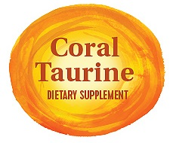
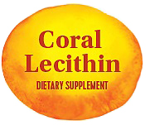

ALSO INCLUDES:
Omega-3s, taurine, carnitine, lecitin
Notes:
The program also includes:
Carnitine – helps burn fat and eliminate toxins; increases stress resilience
Taurine – has a choleretic (bile-stimulating) effect and helps prevent the formation of gallstones
Lecithin – facilitates the breakdown and absorption of fats in the small intestine
Omega-3 polyunsaturated fatty acids (PUFAs) – positively influence the composition of gut microbiota by increasing the number of bacteria that reduce inflammation and lower the risk of obesity

Slide 29
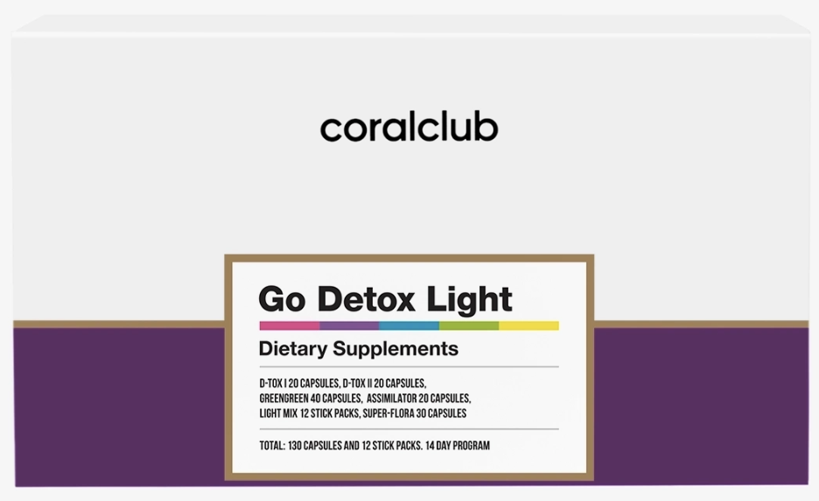
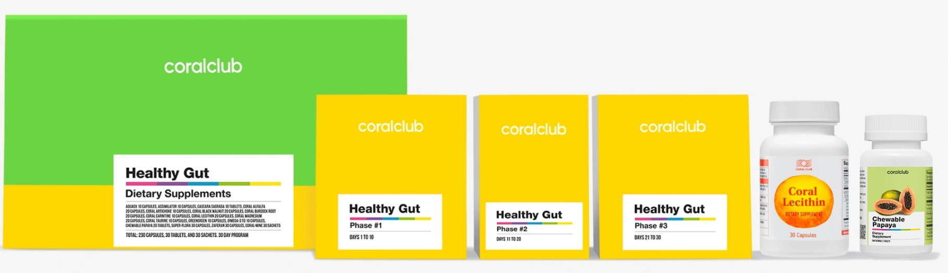
Pairs perfectly with the Go Detox Light program!
CORAL-CLUB.COM
Notes:
“Healthy Gut” can be recommended to those who have completed (or are currently undergoing) the Colo-Vada Plus Program as a comprehensive solution for full-body wellness and strengthening the immune system!

Slide 30

4 Reasons to Choose the Healthy Gut Program
A complete and effective program for healthy digestion*
Convenient: includes dietary tips and recommended dosing
Synergy of active ingredients: vitamins, enzymes, probiotics, fiber, amino acids
Great value: bundle pricing means more savings!
*These statements have not been evaluated by the Food and Drug Administration. These products are not intended to diagnose, treat, cure, or prevent any disease.

Slide 31

Immune System Support*
All included
A systematic approach
A comprehensive effect
Easy to use
CORAL-CLUB.COM
*These statements have not been evaluated by the Food and Drug Administration. These products are not intended to diagnose, treat, cure, or prevent any disease.

Slide 32

A Smart Start to Your Coral Club Journey!
The Healthy Gut Program serves as a perfect entry point for new customers or distributors, providing a powerful launchpad for long-term growth!
CORAL-CLUB.COM
Notes:
The program’s targeted focus and ease of use make it an excellent tool for sales and attracting new customers. Even a beginner Coral Club distributor can easily complete the program on their own—and share it with their network. This means new consumers and clients within the distributor’s structure—the foundation of their sales turnover and growth in the company.
Everyone will have a great opportunity to experience the benefits of 19 Coral Club products at once!

Slide 33
Retail price:
Club Member price:
Point Value:
CORAL-CLUB.COM
Notes:
Bonus Points 55,0
Club Price 90,00
Retail Price 112,50

